Slide 1
Privacy Components That Should Actually Matter to Development Teams
OWASP TORONTO
This work is licensed under CC BY-NC-SA 4.0.

Slide 2

Ross Saunders
NERD WITH TRUST ISSUES

Slide 3
A Bit of Background
Context

Slide 4
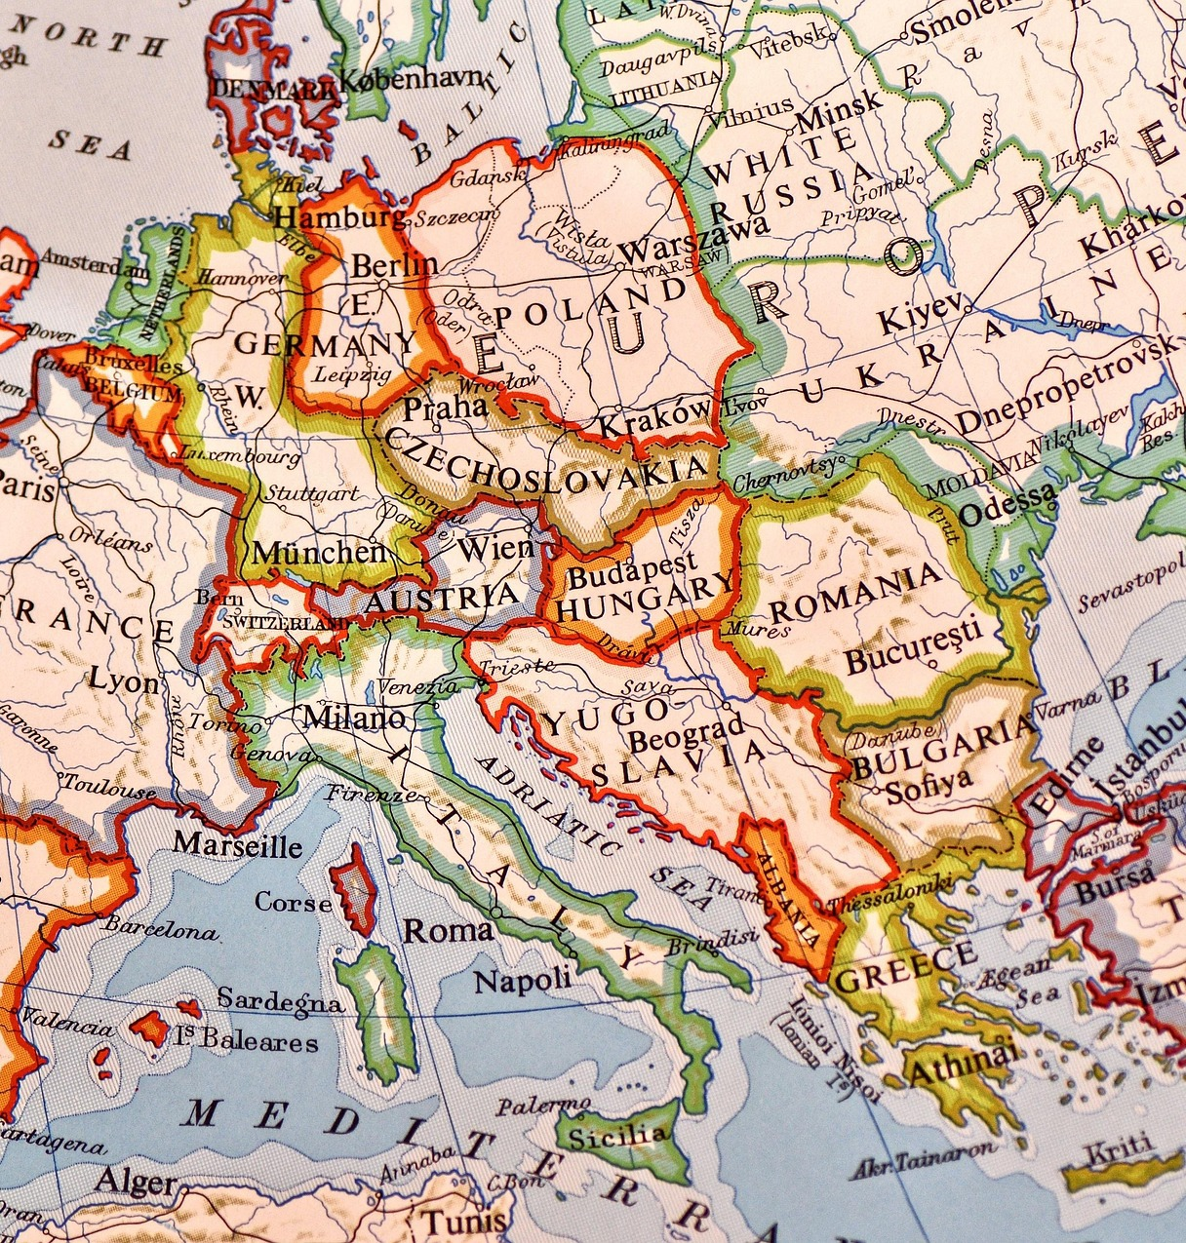
The OECD Privacy Principles
Context
Accountability Principle
Purpose Specification Principle
Use Limitation Principle
Collection Limitation Principle
Data Quality Principle
Security Safeguards Principle
Openness Principle
Individual Participation Principle

Slide 5
Comparison of FOUR LETTER WORDS
Context
Canada | USA | EU/UK | BRICS
PIPEDA | CCPA/CPRA | EU GDPR | LGPD (BR)
Law 25 (QB) | State Specific | ePrivacy | PIPL (CN)
PIPA (BC) | Consumer Watchdogs | UK GDPR + DPA | POPIA (ZA)
PIPA (AB) | Predatory Lawyers | PECR | Russia Challenges

Slide 6

Cookie and Consent Legislation (EU/UK/QUEBEC)
Context
Specifically refer to Cookies AND SIMILAR TECHNOLOGIES (EU/UK), or ANY profiling (QB)
Anything storing to device cache or browser storage qualifies
First party, Third party
Strictly Necessary
Analytics and Performance
Targeting

Slide 7





Data is not just “Sensitive”
Context
PERSONAL INFORMATION
“PI” is any information that can form part of a profile that identifies an individual
PERSONALLY IDENTIFIABLE
SENSITIVE INFORMATION
“PII” is information that specifically identifies an individual.
A category under law. Canada is contextual, EU/UK is very specific
HEALTH INFORMATION
PUBLIC INFORMATION
“PHI” is sensitive information that relates to health, governed by PHIPA / HIPAA and similar
Public information is still subject to obligations under privacy law. You can’t just use it.

Slide 8
How it affects development
Application

Slide 9










OWASP SAMM – Sound Familiar?
Modified from original. OWASP SAMM is published by OWASP under the CC BY-SA 4.0 license
APPLICATION
Strategy and Metrics Policy and Compliance Education and Guidance
Governance
Threat Assessment Privacy Requirements Privacy by Design
Design
FUNCTION
PRACTICE
Secure Build Secure Deployment Defect Management
Implementation
Architecture Assessment Requirements Driven Testing Privacy Testing
Verification
Incident Management Environment Management Operational Management
Operations

Slide 10





GOVERNANCE
APPLICATION
Strategy and Metrics Policy and Compliance Education and Guidance
Have Dev Standards and Policies
Training at Least Annually
The Ability to Track Metrics

Slide 11



DESIGN
APPLICATION
Threat Assessment Privacy Requirements Privacy by Design
Threat Modelling and Risk Assessment
Consent, Notices, and Cookies
Data Subject Request Features

Slide 12



IMPLEMENTATION
APPLICATION
Secure Build Secure Deployment Defect Management
Add(ress) Privacy Issue Types
Keep Calm and Securely Deploy
Keep Devs Out of Prod (RBAC)

Slide 13



VERIFICATION
APPLICATION
Architecture Assessment Requirements Driven Testing Privacy Testing
Build Privacy Test Cases
Data Flow Validation
No Production Data in Test!

Slide 14



OPERATIONS
APPLICATION
Incident Management Environment Management Operational Management
Crossborder Must Be Considered
Address Privacy Debt!
B2C – Build in DSAR Time

Slide 15
OVERVIEW
Modified from original. OWASP SAMM is published by OWASP under the CC BY-SA 4.0 license
APPLICATION
Strategy and Metrics Policy and Compliance Education and Guidance
Governance
Threat Assessment Privacy Requirements Privacy by Design
Design
FUNCTION
PRACTICE
Secure Build Secure Deployment Defect Management
Implementation
Architecture Assessment Requirements Driven Testing Privacy Testing
Verification
Incident Management Environment Management Operational Management
Operations

Slide 16

Thank You for Joining
Here Endeth the Lesson

Slide 17

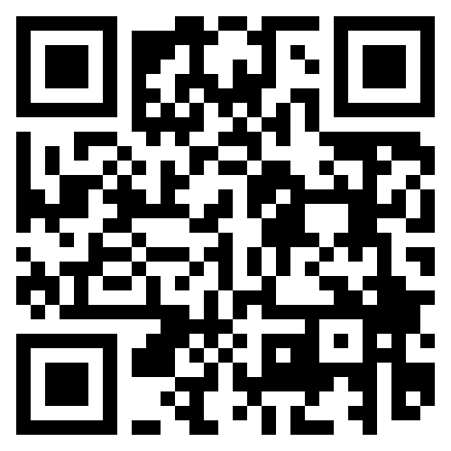

LEARN MORE
nerdwithtrustissues.ca
This is not a Rickroll, I promise.

